Slide 1
Building one UWP app for Xbox and Windows XAML/C#, 20 minutes chrono to build dailymotion (light)!
1
Notes:
Thank you all for being here

Slide 2


November, 2018
Notes:
SOCIAL take photo of crowd and me , for dailymotion

Slide 3


About me
User Product
Xbox & Desktop
Smart TV
Damien Delaire
Technical Lead for the Windows & Smart TV Platform
3
3
Notes:
Working at dailymotion for 4.5 years
MVP for 3 years
Started working at dailymotion as a Windows Phone Software engineer ;P

Slide 4

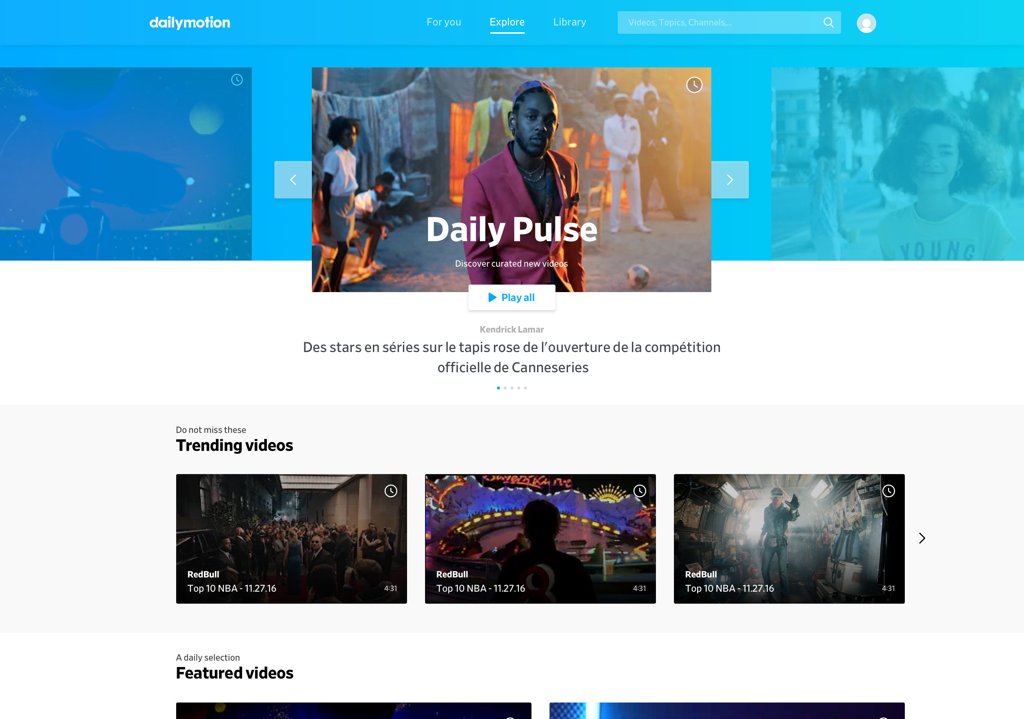
KEY FIGURES
The home for videos that matter
Dailymotion is one of the leading premium video destination platform in the world:
3 billion video views per month
300 million unique visitors per month
150 million 150 million videos in the catalog
4
Notes:
Dailymotion has rebranded in 2017
We relaunched with a new platform and for a new audiance

Slide 5
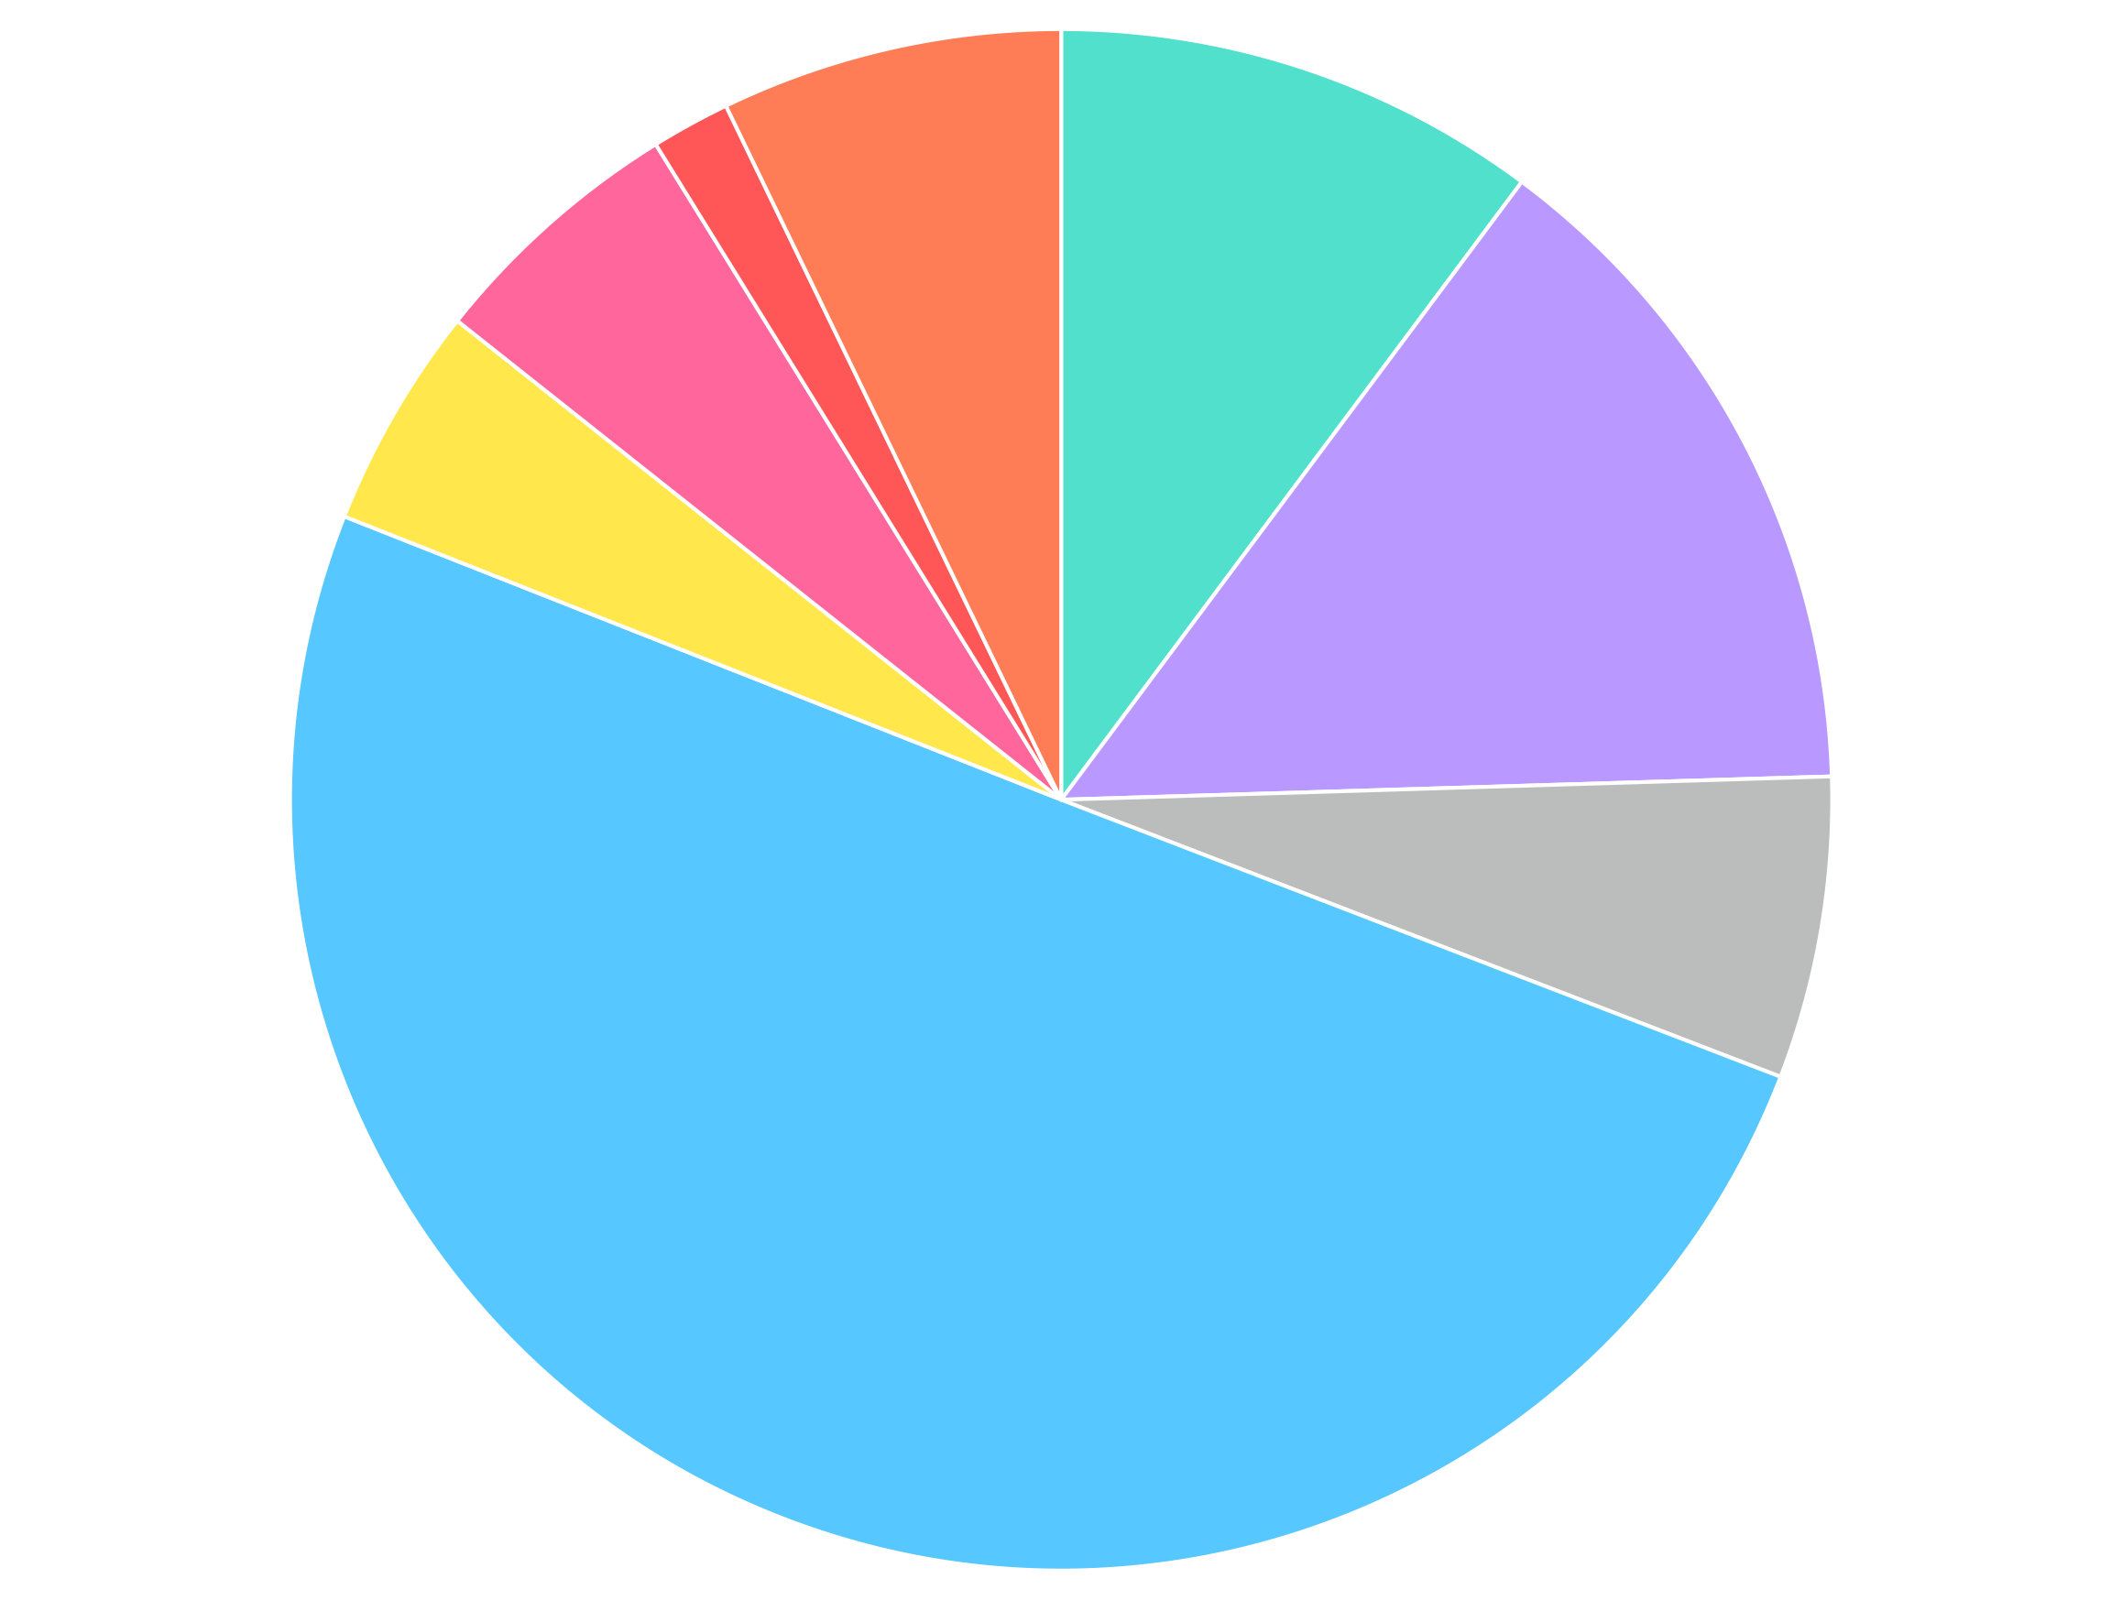
OUR TEAM
Legal
2%
Organization
HR
& Office
7%
Sales
7%
Ad Tech
Ad Squad
10%
Dailymotion engineering team represents 50% of the global staff.
Finance
5%
Ad Tech
Full Stack
14%
Content
6%
Engineering
50%
5
Notes:
Engineering : User product , Partner Tribe , Scale , Data , Design/ UX, Infra

Slide 6
OUR TEAM
Engineering at dailymotion
200+
18%
Engineering people at dailymotion
Engineering women
Our engineering team consists of more than 200 women and men dedicated to ensuring we deliver the best video experience possible to our audience and partners.
10
100
Locations around the world (Paris, New-York, Singapour…)
Talents still to hire (fullstack, font-end, back-end…)
6

Slide 7
OUR COMMON MISSION
Delivering the best video experience
7
Notes:
Our core mission is to bring you the best video experience possible on every platform around the world

Slide 8
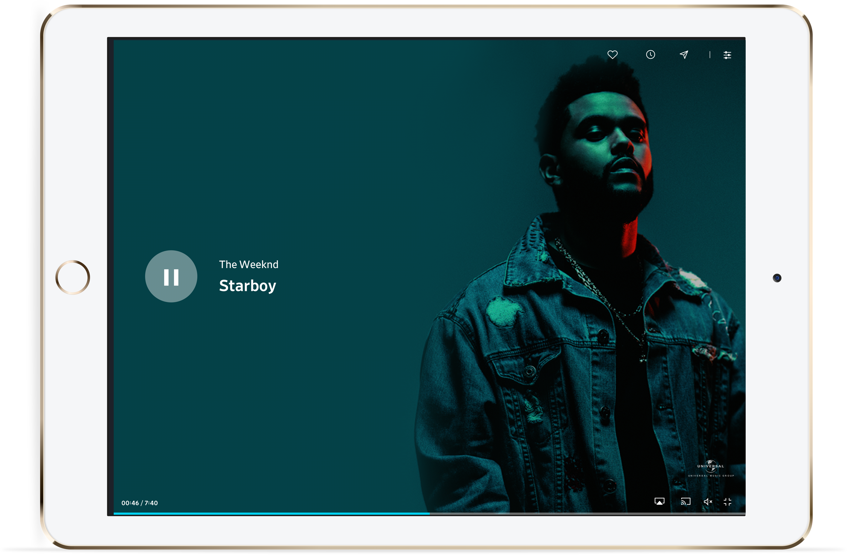
OUR COMMON MISSION
Technology at the service of users
To enable our users to stream videos on the Internet around the world, we had to rely on ourselves and on in-house technologies that allowed us to design and build our own end-to-end video distribution stack.
8
Notes:
We have built our own HTML5 player but also the whole delivery stack around it (servers , encodoers, delivery system etc)

Slide 9
OUR INFRASTRUCTURE
Performance scalability
NEON & GCP
2005
2010
2015
2017
2019
CREATION OF
DAILYMOTION
2 datacenters
based in Paris
& New York
1 million
views per hour
4 datacenters
based in Paris, US & Singapour
2.5 million
views per hour
9 datacenters
based in Europe, US & Asia
5 million
views per hour
NEXT CHALLENGE
1 datacenter
based in Paris
100.000
views per hour
10 datacenters
based in Europe, US & Asia
10+ million
views per hour
462 million files
15.2PB of data
+3000 servers
9
Notes:
New datacenters

Slide 10

OUR INFRASTRUCTURE
New architecture first results
350 ms
vs 400 ms
350 ms
vs 550 ms
400 ms
vs 650 ms
Thanks to this architecture we managed to homogenize our worldwide experience and improve our performances everywhere.
10

Slide 11
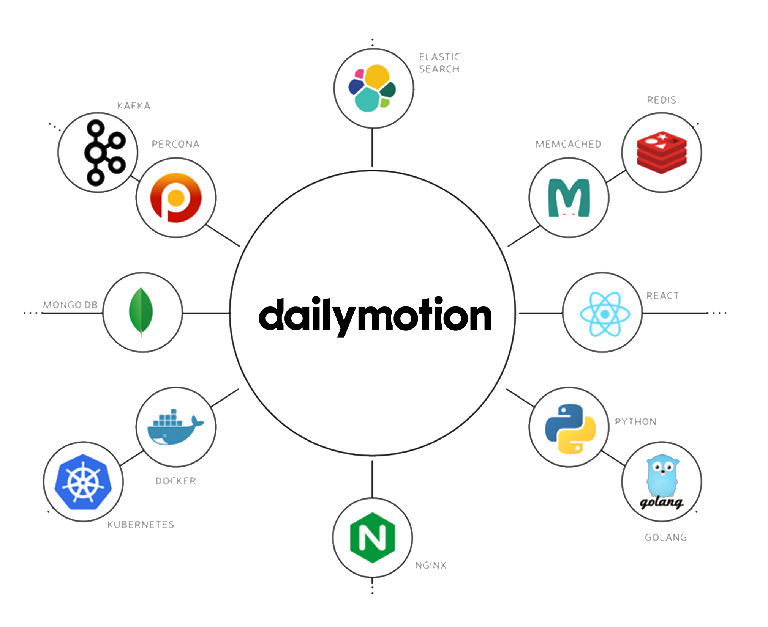
OUR INFRASTRUCTURE
100% API centric
GraphQL ecosystem
We are now able to integrate the best technologies and solutions available on the market.
11

Slide 12
EVANGELISATION
Public REST API
Data API
Our REST API ecosystem allows developers to consume video data for free.
Player API
Developers can embed dailymotion's videos in their website or application using our customizable player.
Our API enable developers to access both data regarding videos, users, comments and to interact with the video player. API calls covers virtually all facets of dailymotion.
API Explorer
It is possible to explore and test every API call with a simple interface and start sending requests.
Video upload
Developers can upload videos on their dailymotion's account(s) programmatically using our API.
12
Notes:
We will be playing with the API explore afterwards

Slide 13
OUR INFRASTRUCTURE
A powerful and accessible API
300m
150k
400m
70ms
monthly active users
registered API keys
average response time
daily API requests
13

Slide 14
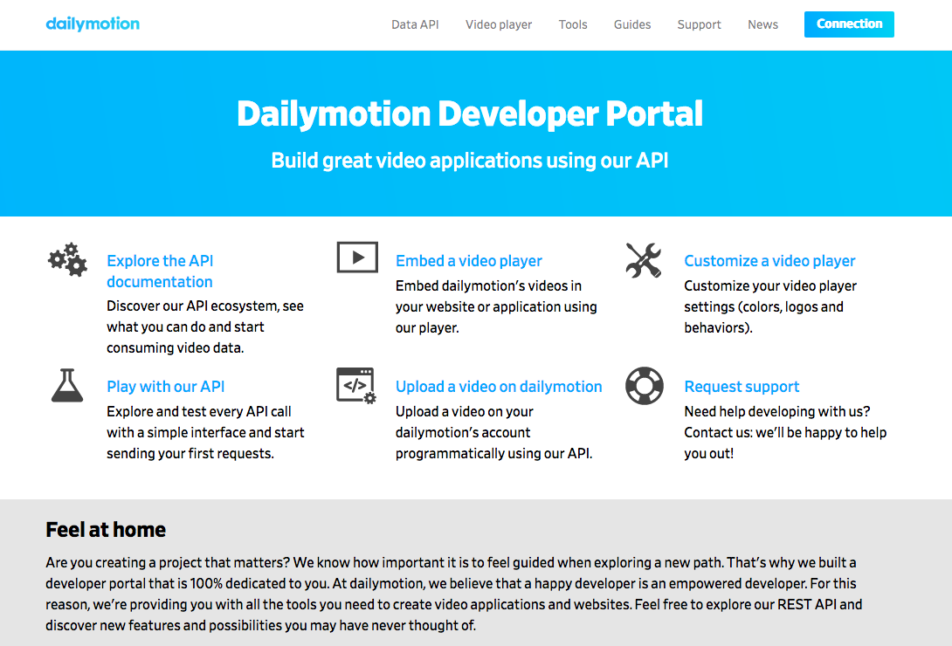
EVANGELISATION
Dev Portal
Our developer portal is designed to answer developers needs with tutorials, guides, news and support. Our objective is to lead them to explore new possibilities they may have never thought of.
14
Notes:
We have developer portal
We have an engeniring blog post on medium

Slide 15
PLAYER
The ultimate viewing experience
15

Slide 16
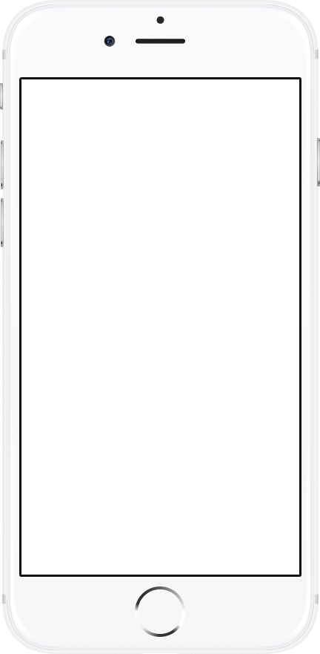
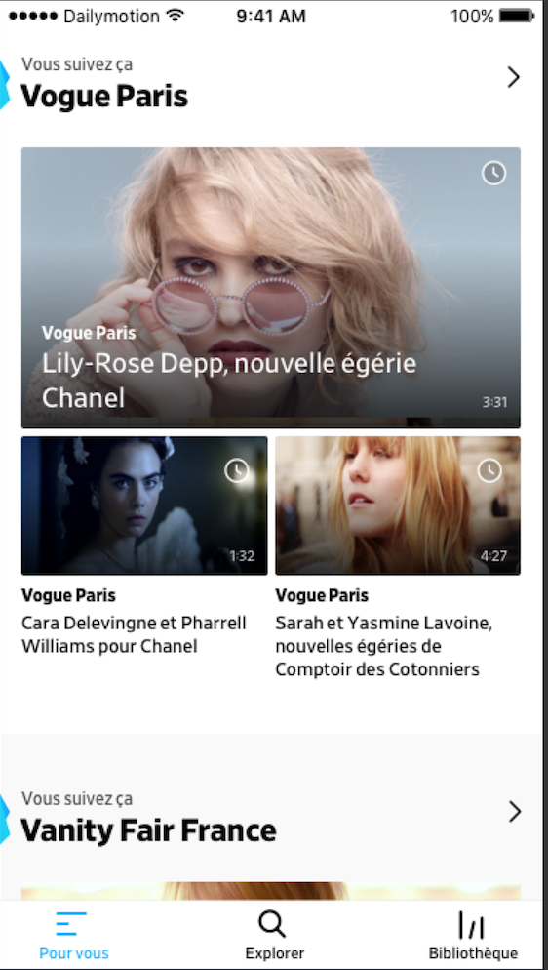
PLAYER
HTML5 Player
Leading
& reliable
Our player technology delivers content across all devices in one flawless streaming experience
Dailymotion offers robust asset management and a variety of content ingestions methods to suit partners needs.
16
Notes:
HTML 5 player used everywhere

Slide 17
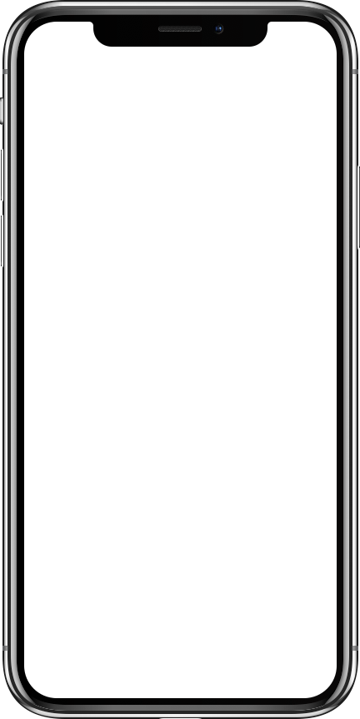
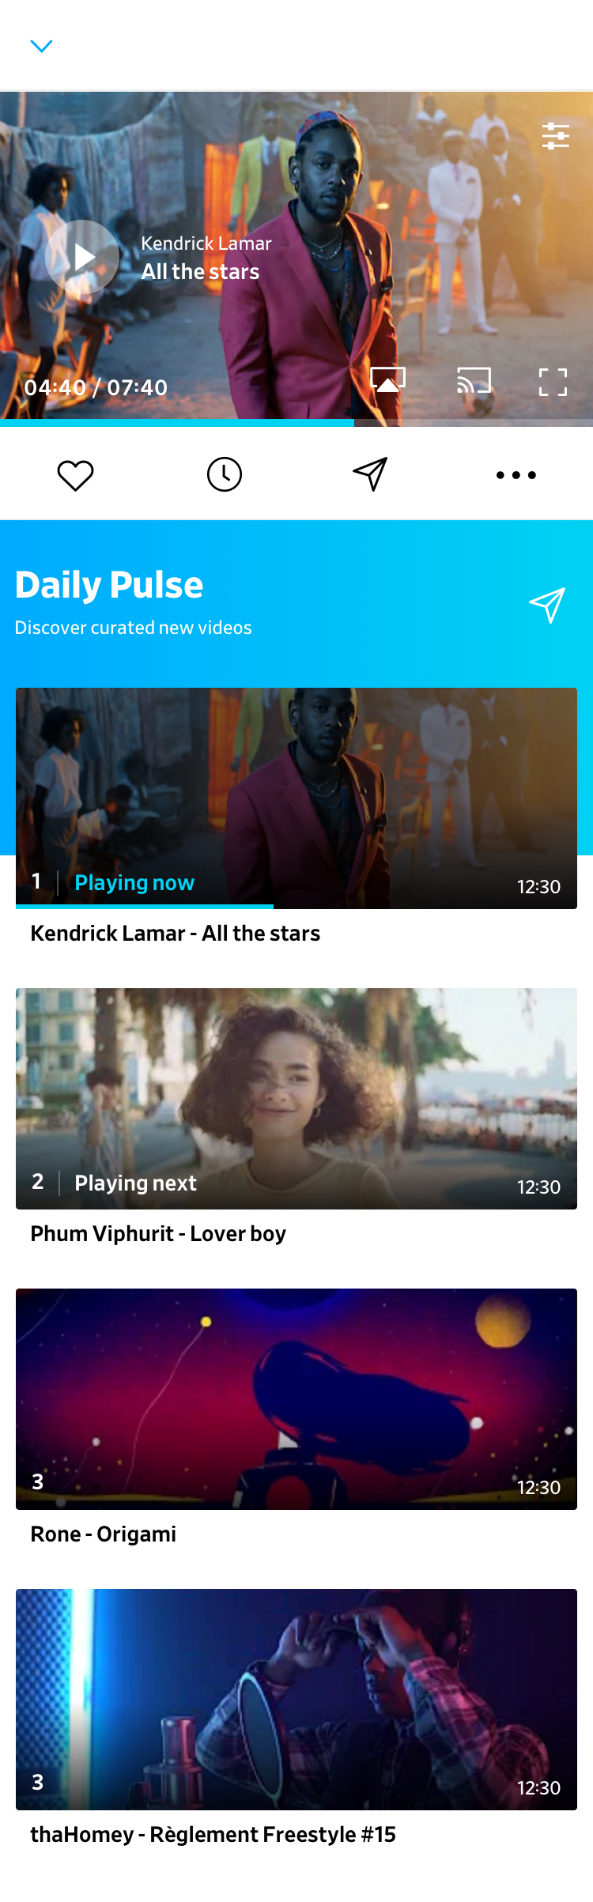
PLAYER
Industry-leading technology
Cross device compatible
User oriented features
Multiple embed options and APIs
Social sharing
Branding and watermarking
Responsive design
Subtitles
Multi-language support
Up next queue
Picture-in-picture
Autoplay & scroll-to-play
Like/watch later…
Full-featured player on touch devices
Embeddable Playlists
VAST & VPAID compliant
17
Notes:
==========
8 minutes here

Slide 18
ADVERTISING PLATFORM
Managing the entire video streaming workflow
18

Slide 19
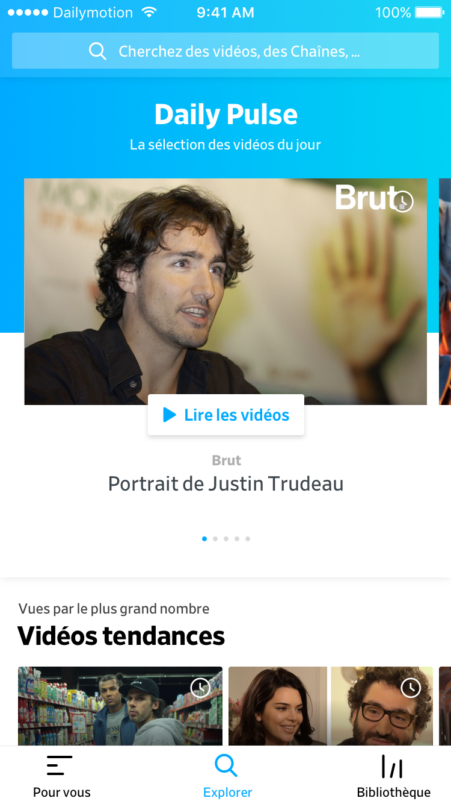
ADVERTISING PLATFORM
Monetization
The only exception we made to our in-house approach was when it came to monetization, where up until very recently we continued to work with external partners.
19

Slide 20
ADVERTISING PLATFORM
2018: our in-house advertising platform is fully operational
SSP
Ad Server
DSP
Our « Sell Side Platform » allows editors to automate and optimize the sale of their advertising spaces.
Our « Ad server » allows announcers to control their media investments and to manage their advertising campaigns. It is governed by a system of bids.
Our « Demand Side Platform » allows announcers and media agencies to optimize their display advertising buying space.
20
Notes:
2 years ago we set out to build our own advertising platform as it would allow us to better handle the delivery and thus the start time of our video

Slide 21
2017 : Building One App for Xbox and Desktop
21
Notes:
Let go back in time, in 2017 dailymotion decided to rebrand and refocus on premium content, this meant rebuilding all of our applications from scratch

Slide 22
Our challenges
Building One
Xbox & Desktop UWP
New watching experience
New UI & UX design
New Architecture
22
Notes:
For our windows application we decided that we would first focus the Xbox and then the Desktop/Tablet platform
This meant our design was TV base first.

Slide 23

User Product
How was the app built
GraphQL
ReactiveUI
MvvmLight
Windows Community Toolkit
23
Notes:
The new app only uses GraphQL which means that the whole API layer of the application was redone

Slide 24
User Product
What do we use?
HockeyApp for crashes
Custom app tracking
Braze for push notifications
DM SDK for player
24

Slide 25
User Product
Some metrics
18k
~2k
lines of code
files (.cs/.xaml)
2.5s
application start time
25
Notes:
The dailymotion app is

Slide 26
Internally we
also use
GitHub
Jira
Zeplin
Applause
26
Notes:
========
11 minutes 0sec

Slide 27
Looking at the dailymotion UWP Xbox/Desktop app
27

Slide 28
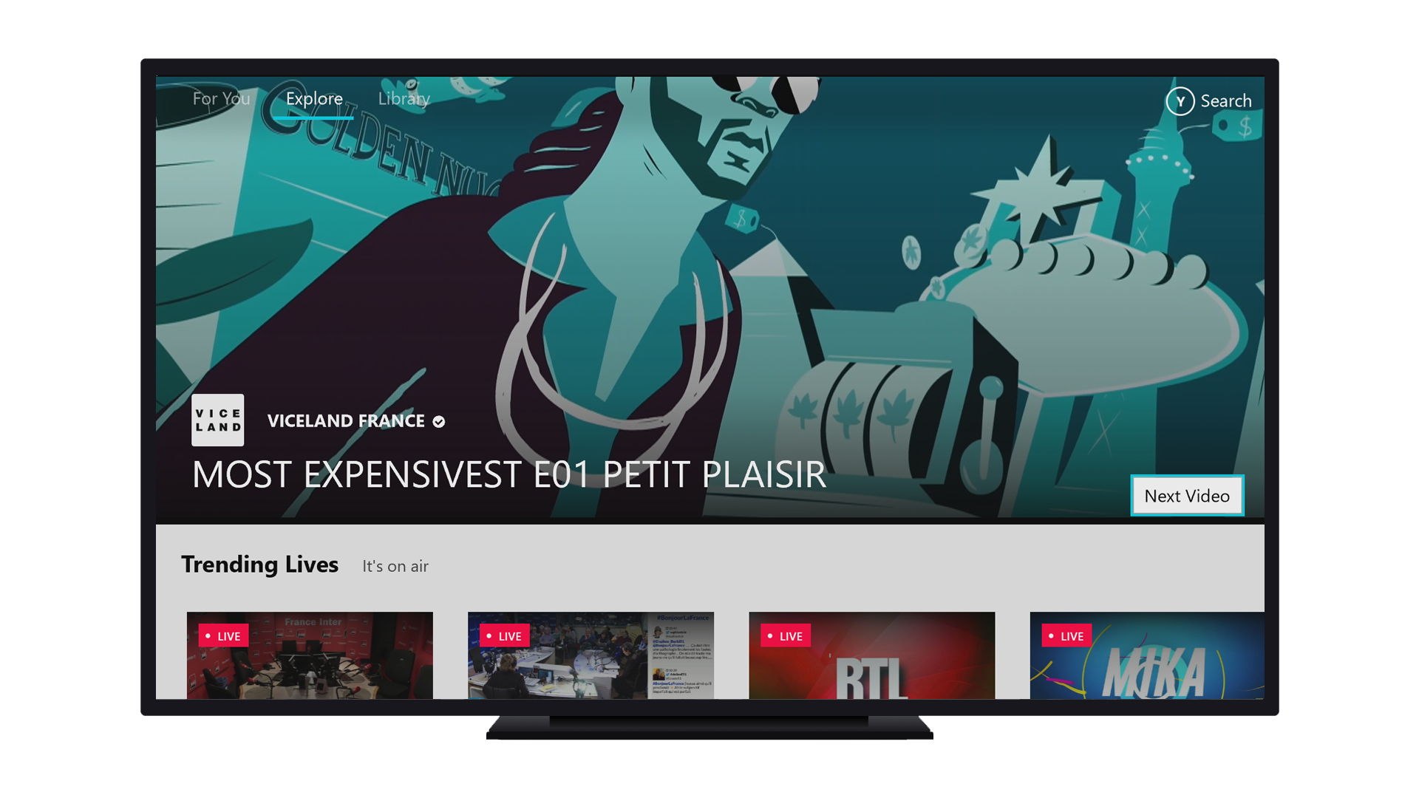
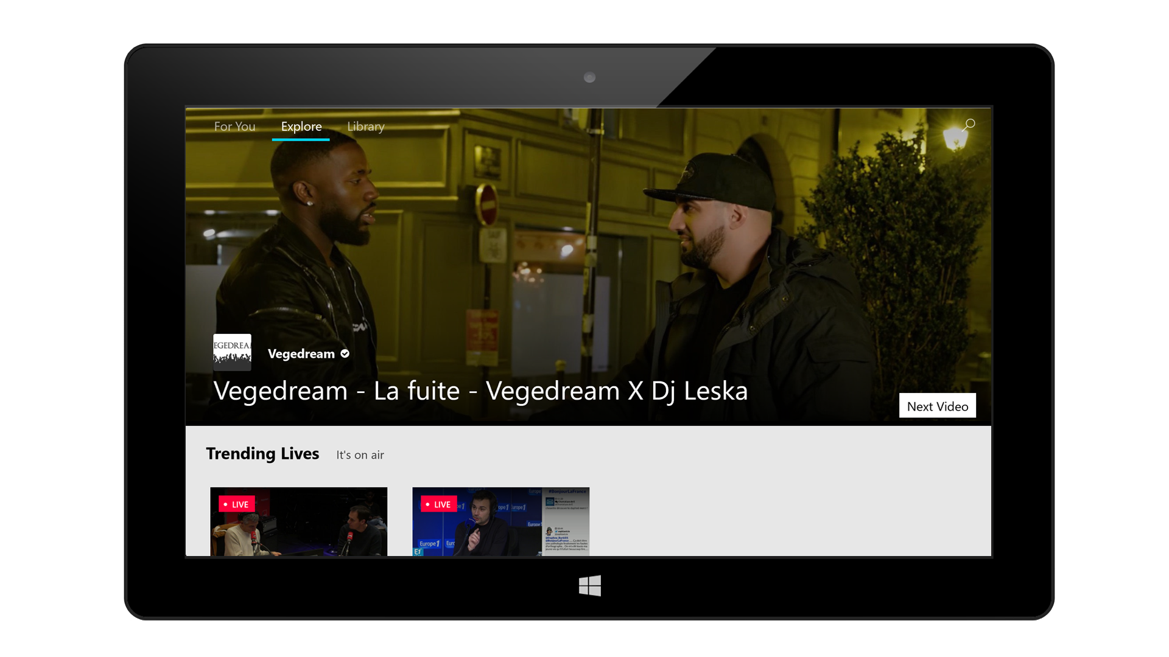
Explore new topics
& find new content (2017)
Notes:
This is the first release of our app in Q4 of 2017.
What we can see is that
Both designs are very similar
they can be as this view is shared for our Xbox and Desktop
We can see that for the xbox version of the app we have added additional information to our user that by pressing the Y btn on your control you can go to the search view

Slide 29
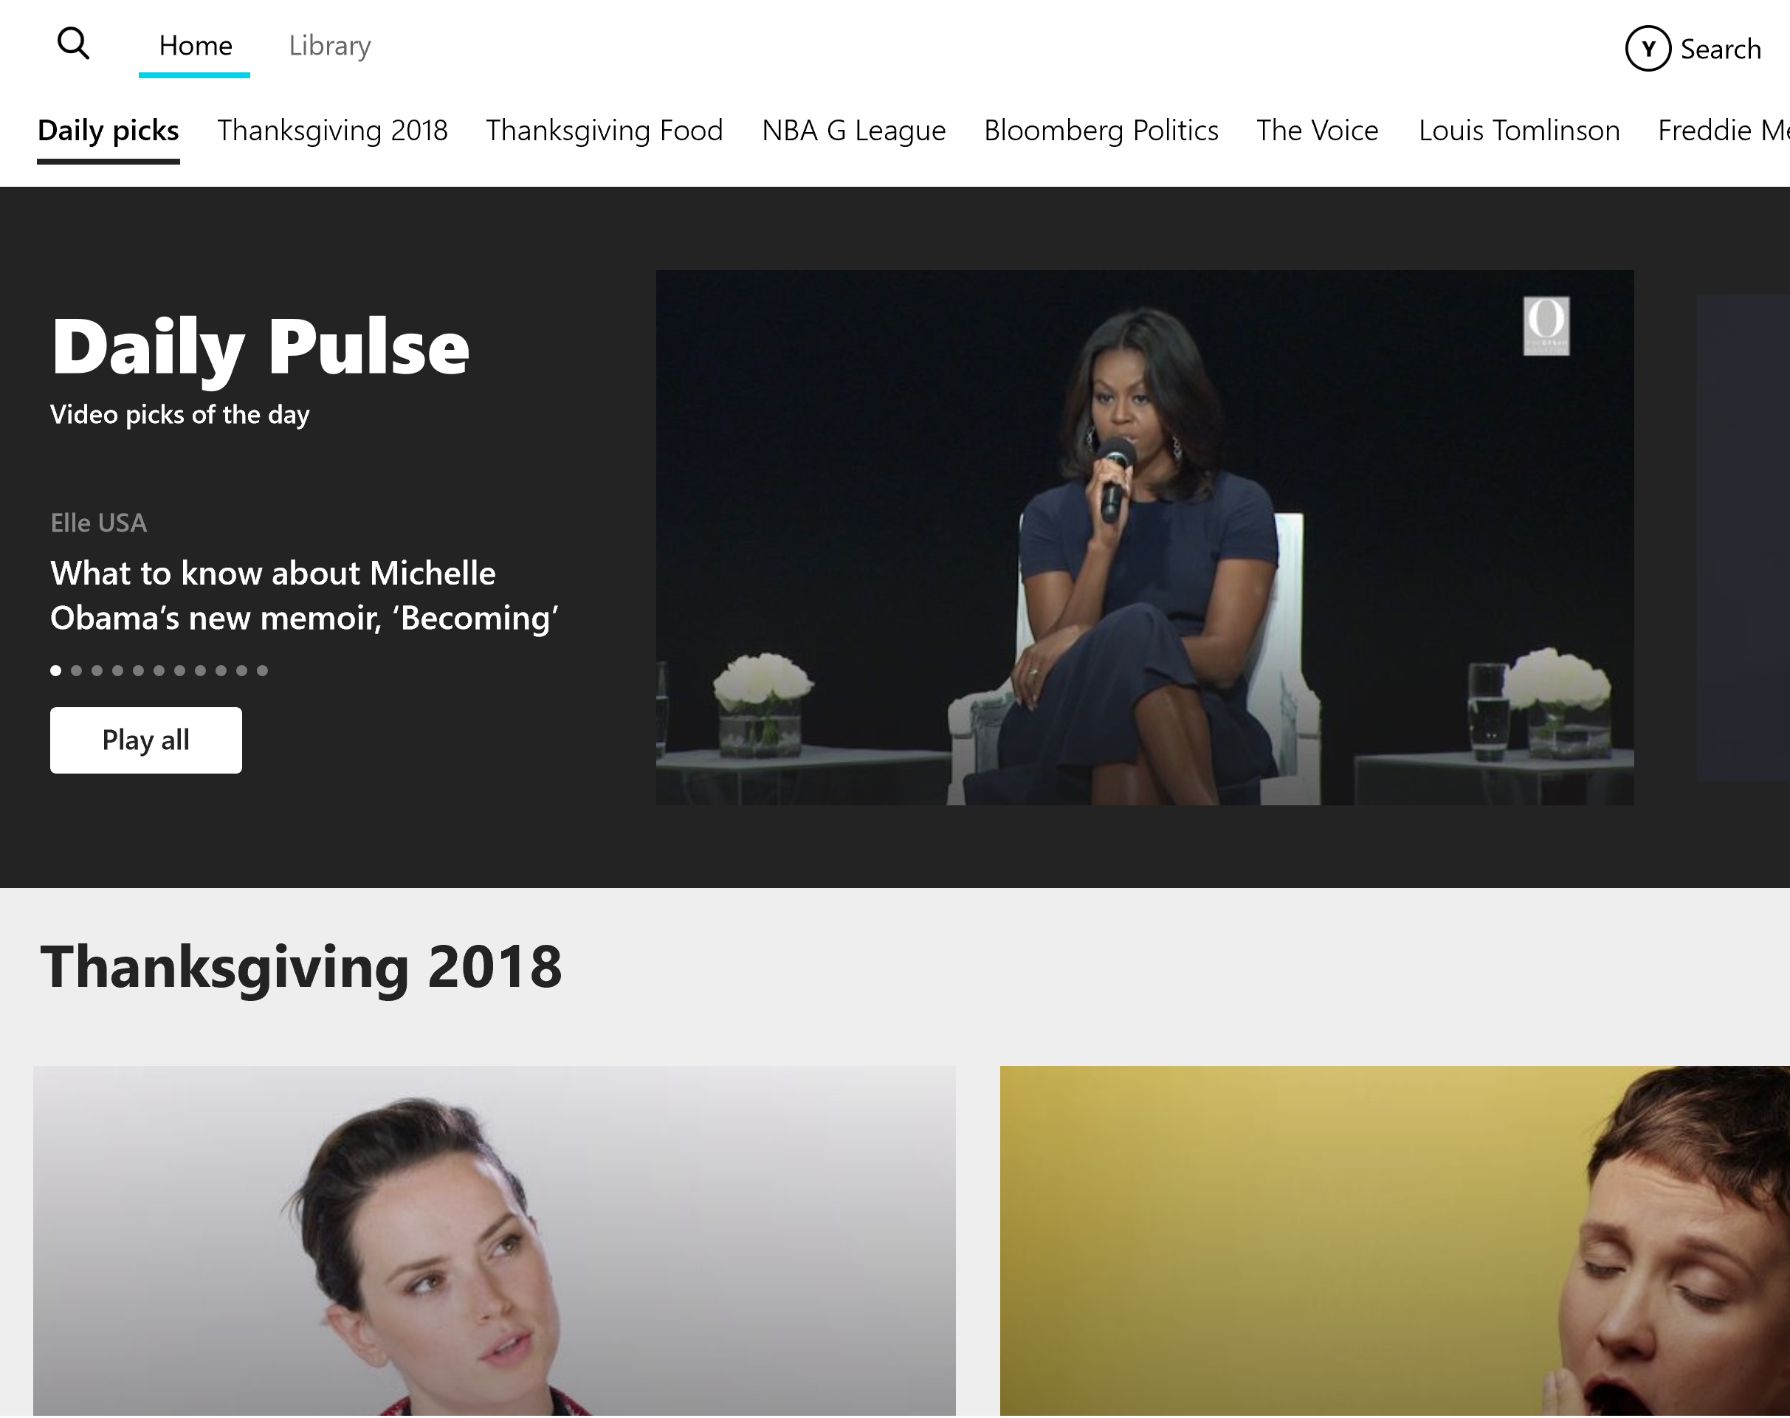
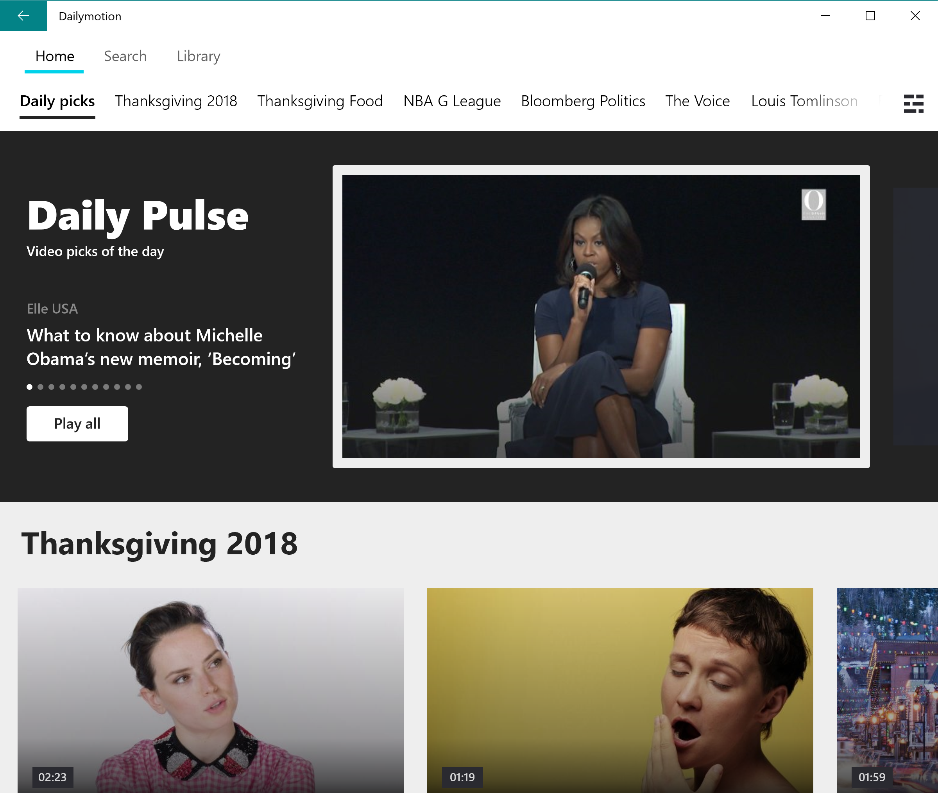
Home (today)
Xbox
Desktop
Notes:
Here is the update application that we released this month
Again we can see some elements that are on the Desktop app that are not on the Xbox app, the main reason is that with a controller these actions would not be accessible and also to reduce the amount of steps needed to acces certain actions
The search is mapped to the Y button of the Xbox Control
On the Xbox application we have remove the catalogue btn /action because it is unaccissible
Video Thumnbnails are larger on the xbox

Slide 30
Building for Xbox
30
Notes:
We will have a look at the guidlines

Slide 31
Xbox
What to keep
in mind
Each TV has its own version of Safe zones
Working inside the safe zone can/will generate issues
Focus traps
Navigation with controller
Colors are not a full 0 -255 range
31
Notes:
Each TV has its own version of Safe zones Sony!=Samsung!=Panasinic
Focus trapping is what happens when a user attempts to navigate an app's UI but becomes "trapped" within a control, making it difficult or even impossible to move outside of that control.
This will mainly happen when you are playing with a webview or a Slider
Colors depending on the TV will seem different then on your screen you can have th eimpression that colors will bleed w
I highly recommend that you set in your styles your own black or white

Slide 32
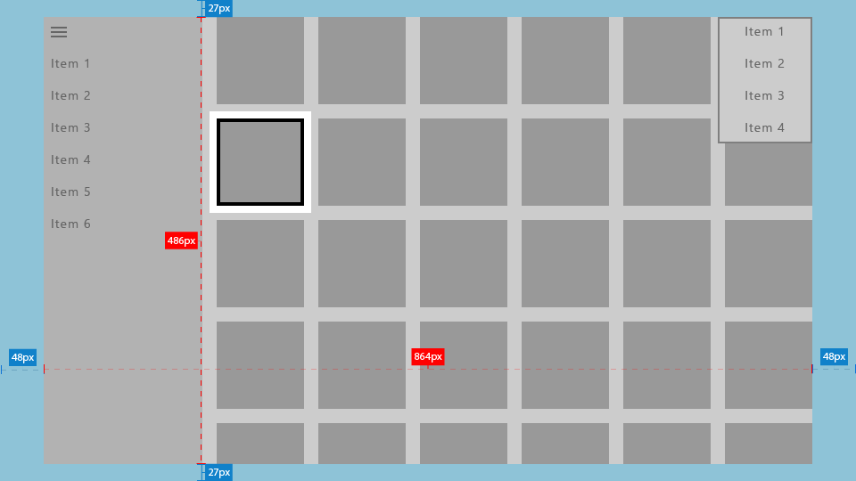
Notes:
Safe Zones, you can go outside which is what we do at dailymotion however for certain TVs we must create workaround because the application is stretched outside of the TV

Slide 33
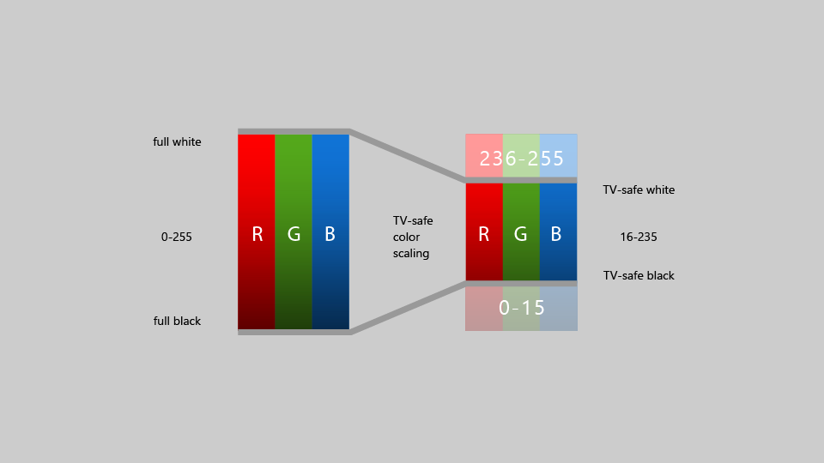
Notes:
Safe Colors:
I highly recommend that you set in your styles your own black or white
For example the dailymotion black is :
<Color x:Key="DmBlack">#232323</Color>

Slide 34
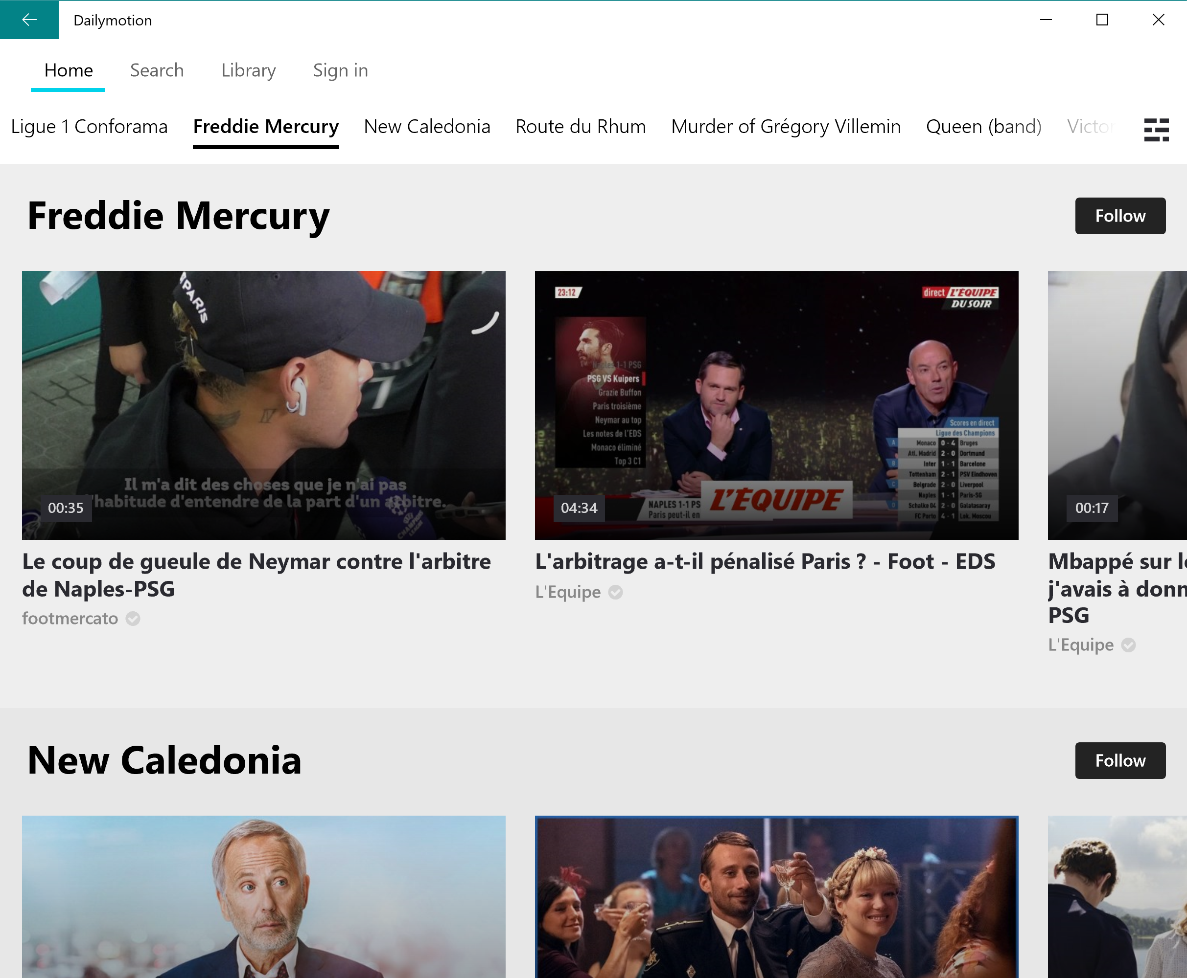
Notes:
Elements removed because not accessible
On Xbox you wont be able to access the follow btn, this is why we have decided to hide these buttons

Slide 35
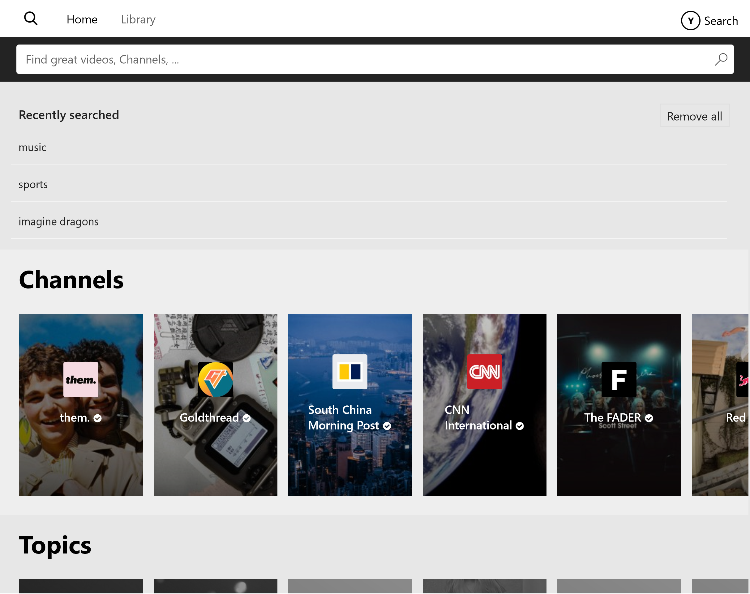
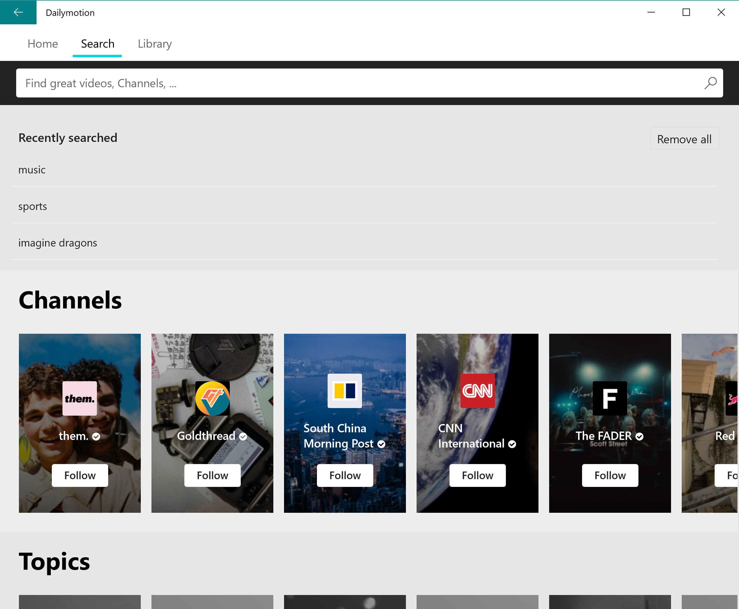
Actions removed on cards
Xbox
Desktop
Notes:
Follow actions are remove because they are not accessible

Slide 36
Navigation on Xbox
36
Notes:
Can be a pain

Slide 37
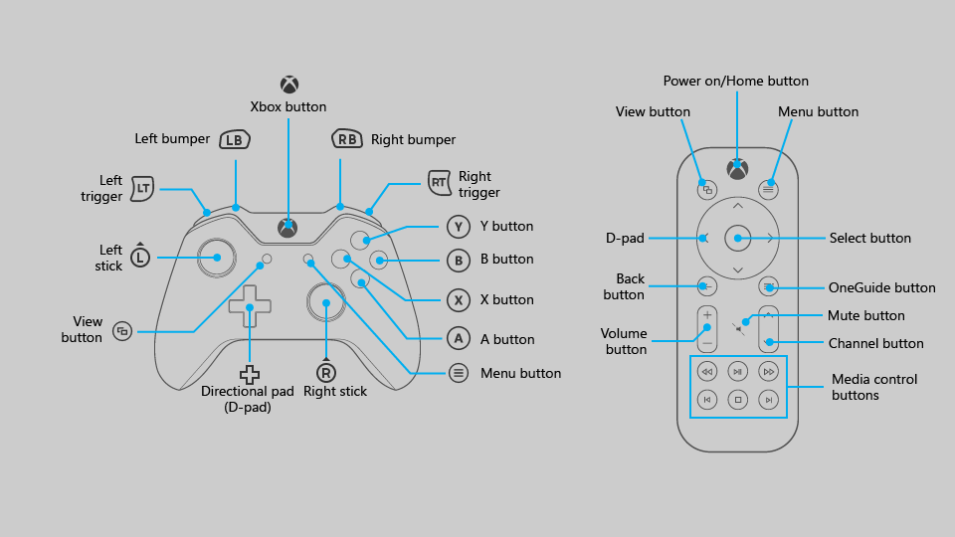
Notes:
If you map a button on the Xbox controller make sure that that button also exciste on the remote or that you also map a button on the remote to perform the same action

Slide 38
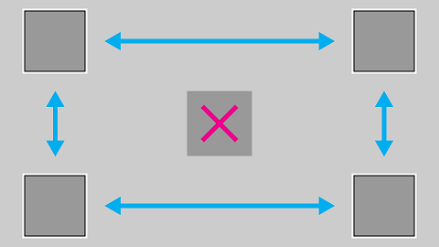
Notes:
Navigation with a controller will be harder
Keep in mind how you set your elements so that all elements can be accessible!

Slide 39
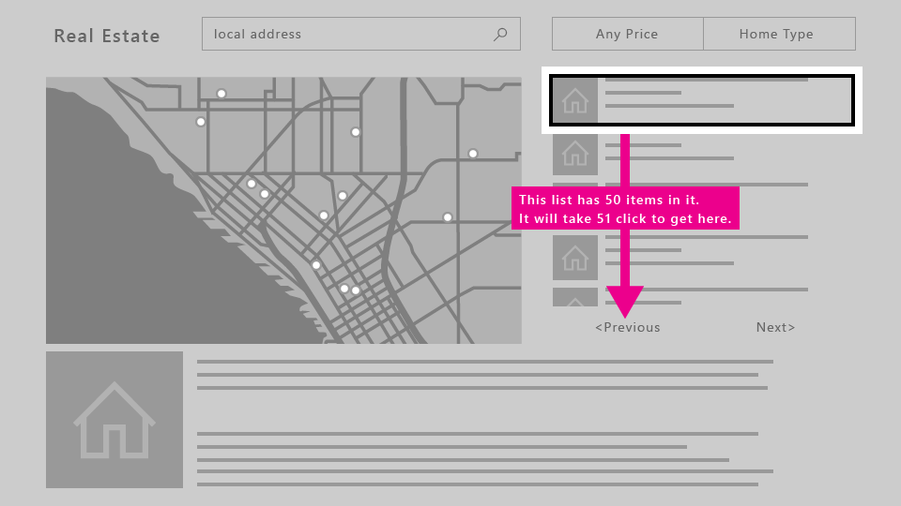
Notes:
Keep in mind that the more elements you add to your view the more clicks the user will have to do to access this element

Slide 40
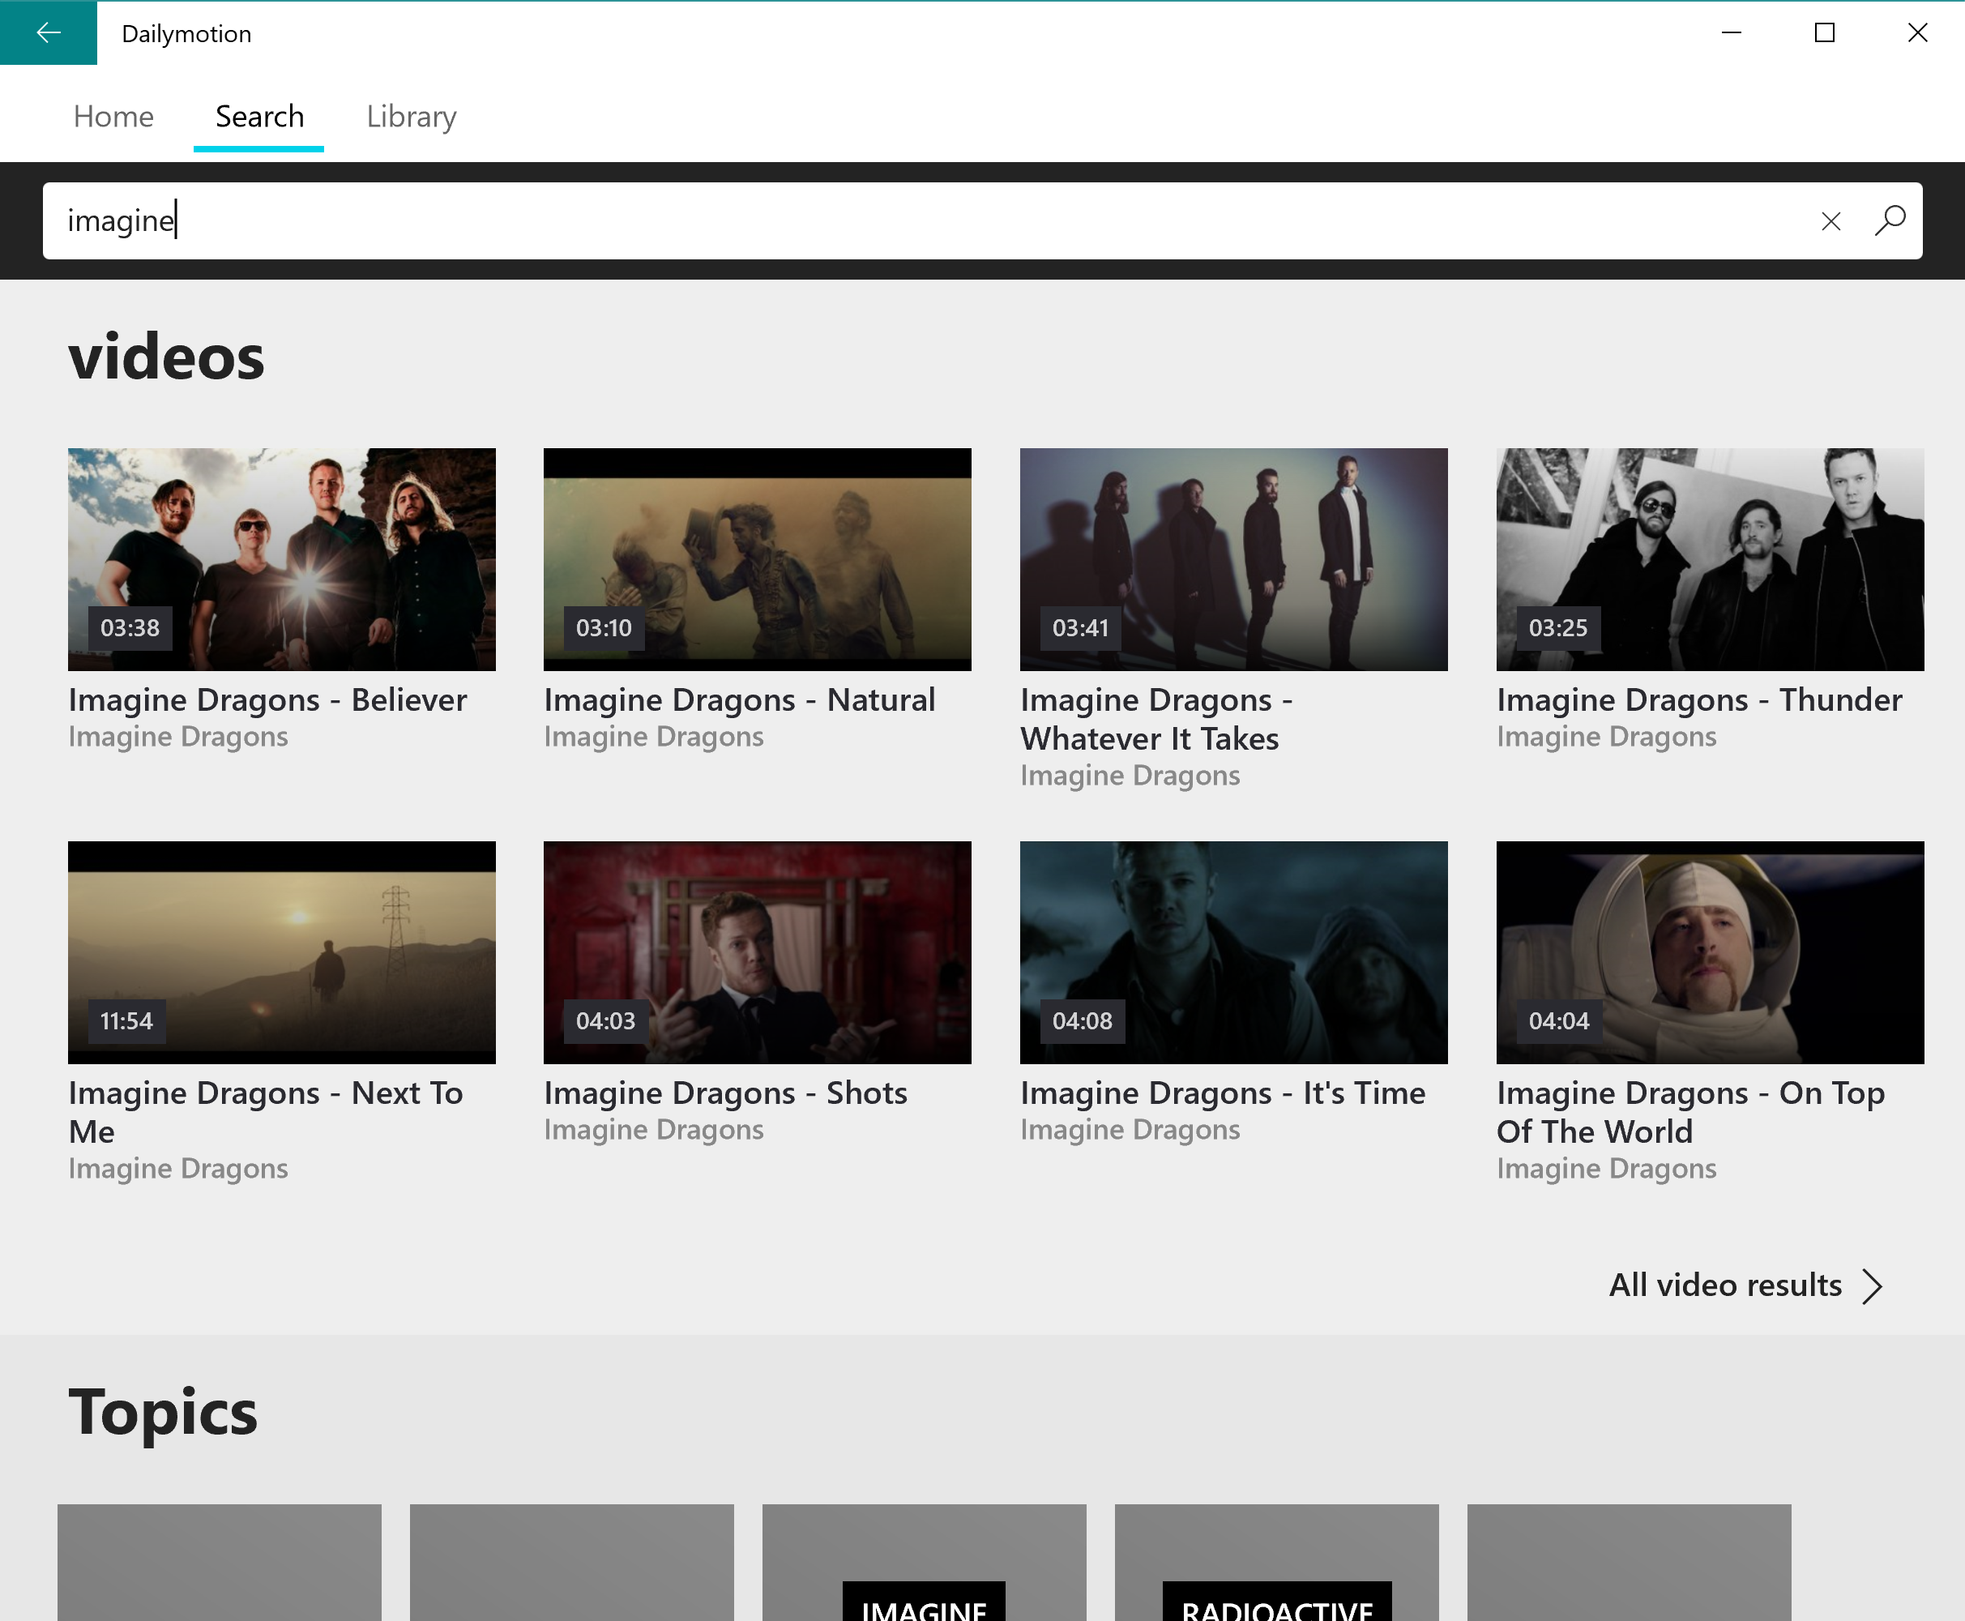
1
2
3
4
5
Notes:
The search on dailymotion has some issues
To access this video, I will have to move 5 times to get there

Slide 41
Focus Traps
41

Slide 42

Focus Traps are everywhere
ListView and GridView with endless loading are traps!
Sliders are traps
ToggleSwitch can be traps
Elements outside of the frame are traps
Webviews will trap you 100% of the time
42

Slide 43
Finding where the focus has gone
43
Notes:
Little game of cat and mouse

Slide 44
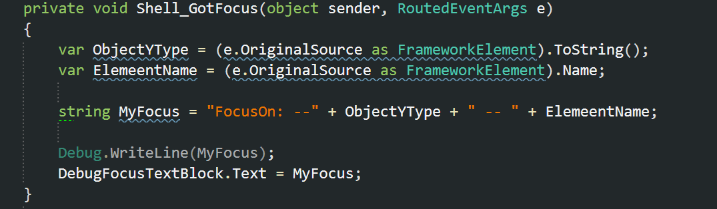
this.GotFocus += Shell_GotFocus;
Method:
44
Notes:
For the dailymotion app I have a Shell that hold the whole app together, so I just need to set this once in your root view or your shell.
Tip:
In the dailymotion app I have remapped the B button on the controller to go back, B is also used by the system to defocus an element (in my case a webview) it took a few attemps to understand why when I was on my video view why I could not go back on the first back and had to sometimes press back twice, this was because the webview would get focused and the back action would be caught by the webview and not the app ^^

Slide 45
Windows Community Toolkit
You don’t like creating components from scratch? The Windows Community Toolkit will save you time!
FocusTracker XAML control : https://docs.microsoft.com/en-us/windows/communitytoolkit/developer-tools/focustracker
And More!!
Source: https://github.com/windows-toolkit/WindowsCommunityToolkit
45
Notes:
This will save you time

Slide 46
Building a UI that can work for Xbox & Desktop
46
Notes:
17 minutes

Slide 47
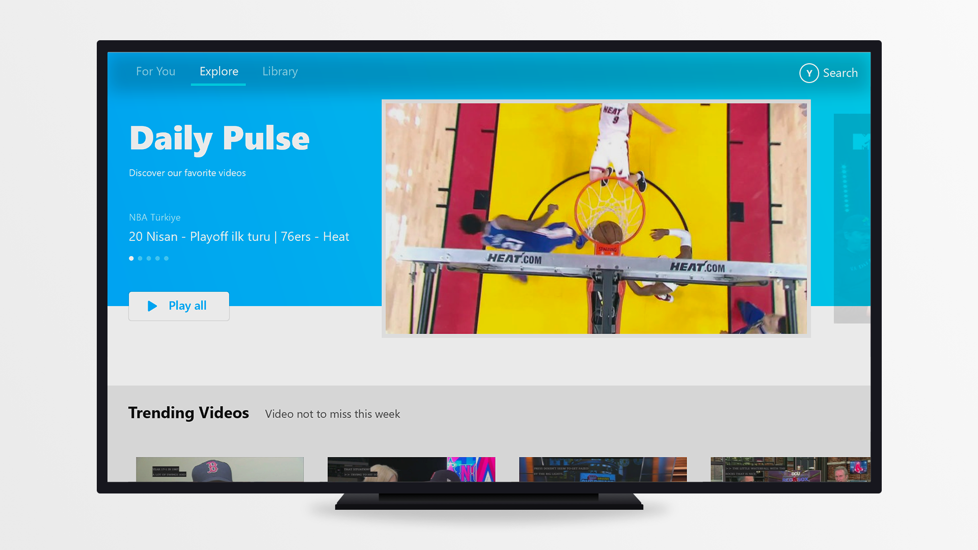
Notes:
A UI that works on both desktop and TV, old version od dailymotion early 2018

Slide 48
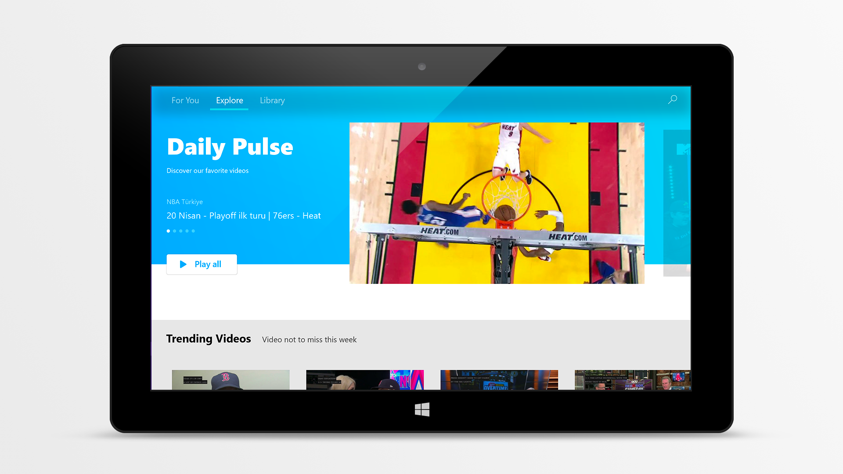
Notes:
Both apps look the same

Slide 49
Today
Xbox
Desktop
Notes:
19 minutes the more the better

Slide 50
StateTriggers
50
Notes:
Instead of writing C# code you can more easily write XAML code

Slide 51
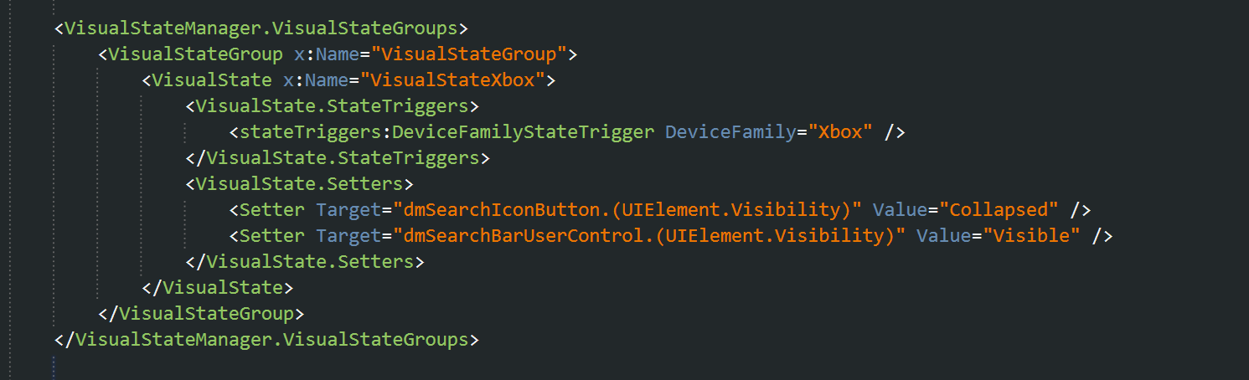
StateTriggers
Create a custom StateTrigger, to detect when your app is running on an Xbox (can be using for other devices too)
51
Notes:
Can also be used to change the size of items in your listview/gridview
Show /hide different elements

Slide 52
Lets build a quick dailymotion Xbox app… on our laptop
52
Notes:
Sorry I could not bring a Xbox =(
I have the next best thing a controller linked to my laptop

Slide 53
What we are going to do:
HTTP Call on Dailymotion Rest API
Mvvm Architecture
Html 5 player SDK
UI & UX that can work on Xbox & Desktop
Using the Xbox Controller on your laptop
53

Slide 54
Step 1
Mvvm setup
Application architecture setup
Dailymotion HTML 5 player SDK
Checks & Windows size for is Xbox
54

Slide 55
Demo – step 1

Slide 56
Step 2
HTTP endpoint
HTTP Models
HTTP service calls
Mapping ViewModel to Listview (x:Bind or Binding)
http://json2csharp.com/ json to model
https://api.dailymotion.com/videos?fields=channel.name,id,thumbnail_url,title, owner.username&sort=trending
https://api.dailymotion.com/video/x5mscur/related?fields=channel.name,id,thumbnail_url,title, owner.username
56
Notes:
Everything is accessible on our developer portal: https://developer.dailymotion.com/tools/apiexplorer

Slide 57
Demo – step 2

Slide 58
Step 3
DataTemplates for video items depending on platform
Starting HTML5 player on Video view
Playing the controller
58
Notes:
If you gave time play with fast forward and rewind with control

Slide 59
Demo – step 3

Slide 60
Join the adventure!
jobs.dailymotion.com

